Slide 1
Git – Introduction
Module 7

Slide 3
Git setup

Slide 4
Scenario overview
You are tired of having different versions of the same scripts running in your environment.
You want to be able to leverage version control within your script repository.
Your engineers are confused on updates and which version of a specific script or file they are supposed to be used.
You want control over your scripts used in the production environment.

Slide 5

What is DevOps?
The union of people, process, and products to enable continuous delivery of value to your end users.
The contraction of “Dev” and “Ops” refers to replacing siloed Development and Operations to create multidisciplinary teams that work together with shared and efficient practices and tools.

Slide 6
DevOps – Deliver Faster, Smarter, and Continuously
Plan
Monitor + Learn
REQUIREMENTS
BACKLOG
Development
Production
Collaboration
Develop + Test
Release
Notes:
So what are the solutions to these challenges?
Applying agile practices to develop ‘Modern Apps’ holds great promise when executed properly:
Faster and more frequent delivery
Higher Quality
Increased Stakeholder satisfaction
Higher ROI – continuous delivery of value
Note the roles engaged in each of the phases – and notice that at the heart of all this is ‘Collaboration’. The whole team is aligned and collaborates throughout the lifecycle.

Slide 7
Introduction To Version / Source Control
Version control of scripts, files, applications, etc.
Records changes to a file or set of files over time
Allows file / project versioning
Local or centralized
Distributed version control change repository option
Easily swap versions
Ideal for teams
Undo changes
Stored on each machine
Notes:
Version control is a system that records changes to a file or set of files over time so that you can recall specific versions later.

Slide 8
Types of Version Control
Distributed
Everyone has a copy
Changes made locally
Centralized
Master copy is stored centrally
Requires network connectivity
Merged with an online central copy
Doesn’t generally require connectivity

Slide 9
CI/CD strategy
Continuous Integration (CI)
Team develops from same repository
Limited drift from master branch
Results contain few bugs
Software works properly
Continuous Delivery (CD)
Produce software/updates in short cycles
Allows: building, testing, and releasing code with greater speed and frequency
Reduces: cost, time, and risk of delivering changes by allowing for more incremental updates to applications/scripts
Notes:
CI: “… a software development practice where members of a team integrate their work frequently, usually each person integrates at least daily - leading to multiple integrations per day. Each integration is verified by an automated build (including test) to detect integration errors as quickly as possible. Many teams find that this approach leads to significantly reduced integration problems and allows a team to develop cohesive software more rapidly.”
Source: https://martinfowler.com/articles/continuousIntegration.html
“… a software engineering approach in which teams produce software in short cycles, ensuring that the software can be reliably released at any time. It aims at building, testing, and releasing software faster and more frequently. The approach helps reduce the cost, time, and risk of delivering changes by allowing for more incremental updates to applications in production. A straightforward and repeatable deployment process is important for continuous delivery.”
Source: https://en.wikipedia.org/wiki/Continuous_delivery

Slide 10
Source Control Management
Harness collaboration
Enable parallel development
Minimize integration debt
Act as a quality gate

Slide 11

What is Git?
Distributed version control system
Created in 2005 by Linus Torvalds
Lightweight and fast
Supports parallel development (branching)
Fully distributed
Open Source
Integrated with many Content Index (CI) tools
Notes:
Source: https://git-scm.com/
Git is a free and open source distributed version control system designed to handle everything from small to very large projects with speed and efficiency.
Git is easy to learn and has a tiny footprint with lightning fast performance. It outclasses SCM tools like Subversion, CVS, Perforce, and ClearCase with features like cheap local branching, convenient staging areas, and multiple workflows.

Slide 12
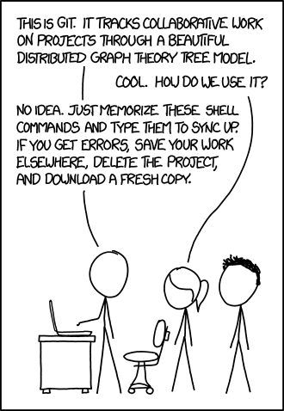
Challenges of Git
New for many operational engineers
Command line based
What’s the point?
Afraid to use Git
New toolset
Very powerful (“Dangerous”)
Not user friendly
I don’t want to become a developer
Notes:
Reference: https://xkcd.com/1597/
Despite the “easy” learning curve, the idea of Git can be a bit much to think about. Once the core concepts are understood, Git becomes an indispensable tool.

Slide 13
Git Commits
Retains each version by tracking ALL changes
Displays exact changes
Undo is holistic and reverts

Slide 14
Git Setup
Clone
Create a new local repository to clone data into
Copy existing repository to clone location
Adds .git folder
Adds remote origin
Run with: git clone ssh_url
Notes:
Presenter note: We talk more about this process in upcoming slides. This is a high level of cloning a project.

Slide 15
Git Structure
A Git repository is created by using git init
Git creates a .git folder
.git folder contains information needed for Git to function
To remove Git, remove the .git folder and retain all project files
Notes:
Reference: https://git-scm.com/docs/gitrepository-layout

Slide 16
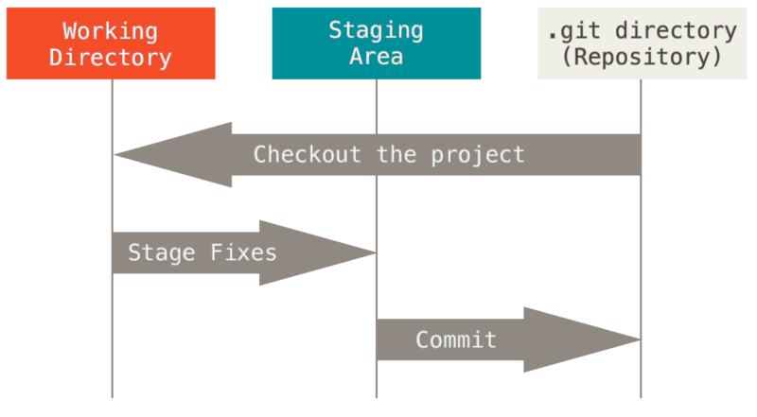
Git Layers
Three stages to track changes:
Working directory
Index/staging
HEAD
Notes:
Reference: https://git-scm.com/book/en/v2/Getting-Started-Git-Basics

Slide 17
Git Process
Working directory
git add
Index/ staging
git commit
HEAD
git push
GitHub
git remote add origin ssh_url

Slide 18
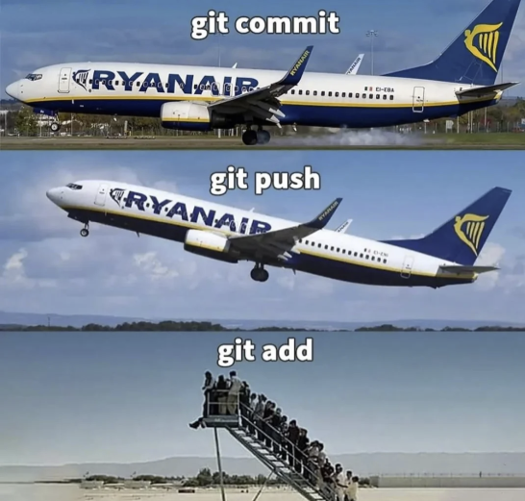

Slide 19
Logging into a Git Repository

Slide 20
Repositories
Can be either hosted online or local (GitHub, GitHub Enterprise)
Represents the main project
Contains: files, commits, branches, and history for the entire project
Best practices:
Maintain a single source repository
Place all needed content for a project in a single repository
Minimize branches
Notes:
GitHub is only one option for hosting

Slide 21
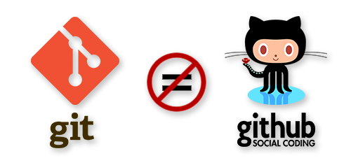
Git vs. GitHub
Git: a revision control system, a tool to manage your source code history
GitHub: a hosting service for Git repositories, only stores code
Notes:
Many other Git repositories exist but GitHub is one of the most popular.

Slide 22
Create Repository
Create New – git init <RepositoryName>
Clone from another location – git clone <location .git>
A local copy of source files is available
PS c:\> git init MyNewRepository
Initialized empty Git repository in C:/MyNewRepository/.git/
PS c:\> git clone https://github.com/anwaterh/MyNewRepository.git
Cloning into 'MyNewRepository'...

Slide 23
Workspace / Staging Area
Files are created / edited in your workspace
To track a file it first must be added to the staging area
Staged files can then be committed (snapshot of the current staging area)
All files / changes can be added – or only individual files
Create New File(s)
Add to Staging Area
Commit File(s)

Slide 24
Adding Content to Staging Area
Add a file to staging area – git add <filename>
Add all files to staging area – git add .
PS c:\MyNewRepository> git add .\script.txt
PS c:\MyNewRepository> git status
On branch master
No commits yet
Changes to be committed:
(use "git rm –cached <file>... " to unstage)
new file: script.txt

Slide 25
Removing Staging Area Content
Remove a file from staging (won’t be part of the commit)
PS c:\MyNewRepository> git rm .\script.txt –cached
Rm 'script.txt'
PS c:\MyNewRepository> git status
On branch master
No commits yet
Untracked files:
(use "git add <file>..." to include in what will be committed)
script.txt
Nothing added to commit but untracked files present (use "git add" to track)

Slide 26
Commit
Snapshots the repository at that point
All staged files become part of the commit
Saves email address and username
Contains a message describing the changes
Commit has a unique hash which is used as a reference
Use a text editor or the –m switch to provide the message

Slide 27
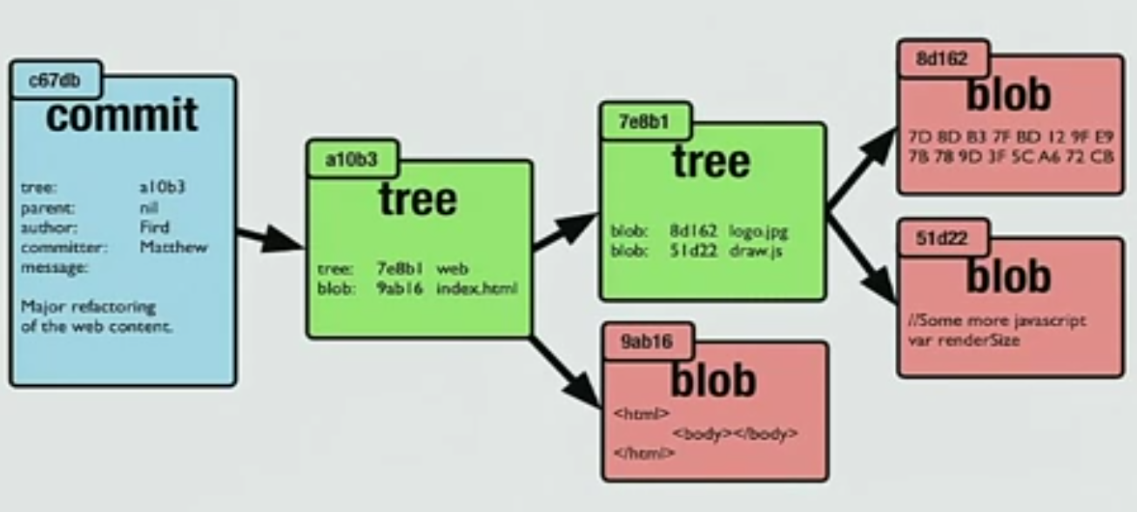
Commit - Under the Hood
Commit stores the entire blob, not just deltas as hashes: 530a6ac7c3682458ec6307a7c2c350ed849bfaf7
Not duplicating content – leverage same blob
Multiple commits can point to the same blob content
Commit points to a tree, then to a blob
Object DB used
Start with root tree
Updates parent
.git folder to start

Slide 28
Committing Changes
Commit all changes – git commit –m “<commit message>”
Use the –amend switch to change the last commit
PS c:\MyNewRepository> git commit –m “My commit"
[master 67b2b30] My commit
Date: Tue Apr 10 16:21:50 2018 +1000
1 file changed, 0 insertions(+), 0 deletions(-)
create mode 100644 script.txt
PS c:\MyNewRepository>
PS c:\MyNewRepository> git commit –m "Altered commit" --amend
[master 67b2b30] Altered commit
Date: Tue Apr 10 16:21:50 2018 +1000
1 file changed, 0 insertions(+), 0 deletions(-)
create mode 100644 script.txt
PS c:\MyNewRepository>

Slide 29
Viewing History
Git log
PS c:\MyNewRepository> git log
Commit ebf96ff9862bc450a4b61c48742c0ec64639d1c (HEAD -> master)
Author: Anthony Watherston <anwather@contoso.com>
Date Tue Apr 10 16:25:40 2018 +1000
Made a small change
Commit 67b2b30e8cc6b8167ba947a55440730951ac44bq
Author: Anthony Watherston <anwather@contoso.com>
Date Tue Apr 10 16:25:40 2018 +1000
Altered commit

Slide 30
History Options
Many options to condense output and add decorations
PS c:\MyNewRepository> git log --oneline
ebf96ff (HEAD -> master) Made a small change
Commit 67b2b30 Altered commit
PS c:\MyNewRepository> git log –oneline --graph
* ebf96ff (HEAD -> master) Made a small change
* Commit 67b2b30 Altered commit
PS c:\MyNewRepository>

Slide 31
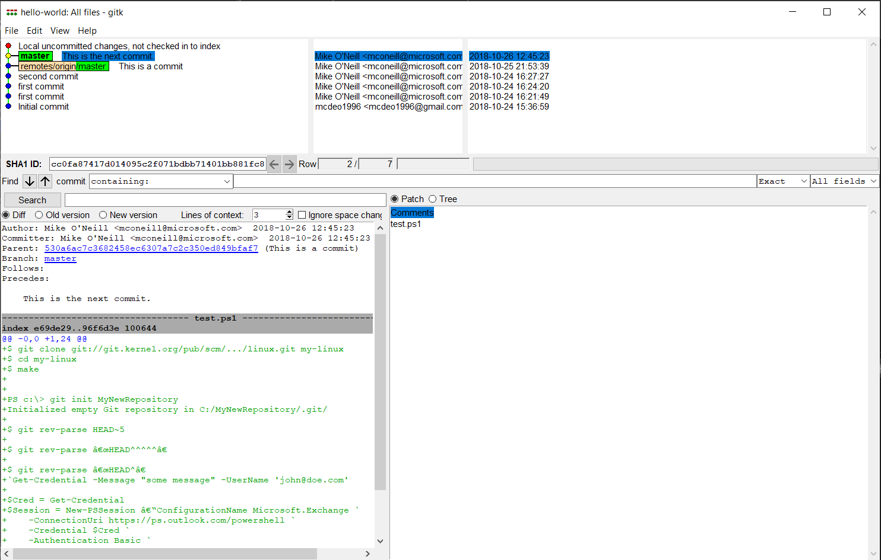
History Options Cont.
Use gitk for a GUI history

Slide 32

Demonstration
Advanced Features
Notes:
Consider demoing this as you go. You can view the demo ps1 and video in the instructor folder.
configure git with a usename and email
Install posh-git
Make a new directory, init a first repo
Make a file, add that file
Show git status
Commit
#need e-mail and user for git repository
git config --global user.name "your name here"
git config --global user.email "your email here"
#install the Posh-git module that has colors and information at the command prompt.
Install-Module posh-git -force
#create folder if not already created
New-Item -ItemType Directory 'c:\temp\Repos' -ea 0
#change directory to new folder created
Set-Location C:\Temp\Repos
#create repo
git init MyFirstRepo
#create file and add content
New-Item myfile.txt | Set-Content -Value "This is some text"
#add files
git add .
#get status of git
git status
#commit to git repo
git commit -m "My first commit"
git commit
#show the log of the git repo changes/commits
git log –oneline
#####

Slide 33

Git – Introduction (45 minutes)
Installing Git
Setting up first repository
Notes:
Please inform students to fire up next lab BEFORE you start next powerpoint, It take labsetup +- 10 minutes to get lab ready !!!
##########

Slide 35

Why use version control?
Version control simplifies complex coding tasks: It helps manage changes to your code, making it easier to add features and fix mistakes without confusion.
Time travel and alternate timelines: You can take snapshots of your work, create branches for new features, and revert to previous versions if needed, much like traveling back in time or exploring alternate timelines.
Efficiency in development: Using version control makes building, debugging, and deploying code more efficient by allowing you to manage and merge different versions seamlessly.

Slide 36
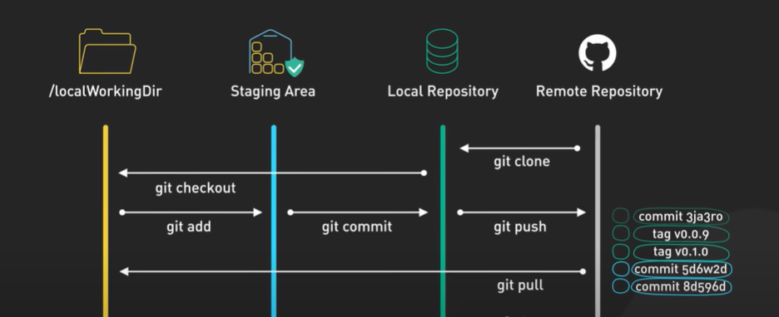
Git architecture

Slide 37

git init: Initialize a repository
Initialization of a Git repository: The git init command is used to create a new Git repository in the working directory of your project.
Tracking changes: Once initialized, Git monitors all changes in the directory, including the smallest modifications, and keeps a historical timeline of these changes.
Main branch creation: The first branch created by Git is named "main," representing the main historical timeline of the project.

Slide 38
.gitignore: Ignore files
Purpose of .gitignore: The .gitignore file is used to specify files and folders that Git should ignore and not track.
Usage: You can list the names of files and folders in the .gitignore file to exclude them from version control.
Reversing Ignored Files: If you want Git to start tracking a previously ignored file, simply remove its entry from the .gitignore file.

Slide 39
git add: Add changes
Staging Area: The git add command is used to place changes into the staging area, preparing them to be committed to the project's history.
Selective Addition: You can specify which files to add by naming them individually or add all changes using the -A option.
Controlled Commit: This command allows you to pick and choose which changes to include in the next commit, giving you control over what gets recorded in the project history.
Remove content from staging area: git rm .\script.txt –cached

Slide 40
git commit: Commit changes to memory
Purpose of git commit: The git commit command is used to add changes from the staging area to the project's history, creating a snapshot of the current state.
Commit Messages: When committing, you add a message with -m to describe the changes, making it easier to understand the project's history.
Frequent Commits: It's better to commit changes often to ensure a detailed and manageable history of your project.

Slide 41
git status: Get the current status
Check Changes: The git status command shows what changes have been made in your project since the last commit.
File Status: It lists each changed file and indicates whether the changes are staged for commit or not.
Project Snapshot: Running git status provides a snapshot of the current state of your project, helping you understand what needs to be committed or further modified.

Slide 42
git branch: Create an alternate timeline
Branches as Alternate Timelines: Branches in Git allow you to create alternate timelines for your project, enabling you to develop new features or experiment without affecting the main codebase.
Parallel Development: You can switch between branches to work on different versions of your code in parallel, maintaining a stable main branch while developing experimental features in separate branches.
Team Collaboration: Different team members can work on their own branches, creating multiple timelines that can later be merged back into the main branch seamlessly.
GUI to visualize all branches: gitk --all

Slide 43
Branching – why needed
Team A
Feature A
Commit
Feature A
Commit
Team B
Master Branch Commit
Feature B Pull Feature A
Feature B Commit
Feature B Pull Feature A

Slide 44
Branching – solution
Feature Branch A
Commit
git branch feature_a
git checkout feature_a
git checkout –b feature_a
Team A
git branch feature_b
git checkout feature_b
git checkout –b feature_b
Team B
Master Branch Commit
Feature Branch B Commit 1
Feature Branch B Commit 2
Feature Branch B Commit Nth

Slide 45

Branching – merging cont.
Feature Branch A
Commits
Team A
git merge feature_a
Conflicts flagged
Team B
Master Branch Commit
git merge feature_b
Feature Branch B Commits

Slide 46
HEAD: An introduction
HEAD Pointer: The HEAD pointer in Git indicates your current position in the project's history, pointing to the latest commit on the active branch.
Branch Navigation: When working with multiple branches, the HEAD pointer moves to the latest commit of the branch you're currently working on.
Time Machine Concept: Think of the HEAD pointer as a time machine that allows you to navigate and work within different points in your project's timeline.

Slide 47
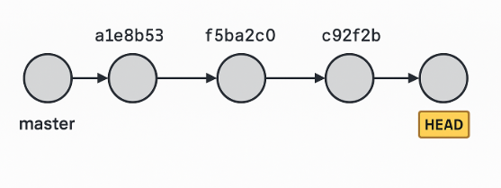

Slide 48
git checkout: Go to an alternate timeline
Branch Switching: The git checkout command can be used to switch between branches, similar to the git switch command.
Commit Navigation: You can use git checkout to navigate to any specific commit by providing its commit ID, allowing you to work on code from a previous point in time.
Interchangeability: While git switch is a newer command, git checkout is still commonly used in documentation and tutorials for branch switching, and both commands are interchangeable for this purpose.

Slide 49
git switch: Go to an alternate timeline
Switching
Switching Branches: The git switch command allows you to move between different branches in your project.
Handling
Conflict Handling: If there are uncommitted changes that conflict with the branch you're switching to, Git will abort the switch to prevent data loss.
Resolving
Resolving Conflicts: To resolve conflicts, commit your changes on the current branch before attempting to switch to another branch.

Slide 50
DETACHED HEAD: An explanation
Detached Head Warning: When you check out a commit in the middle of a branch, Git issues a "Detached Head" warning, indicating that you are working outside the main timeline.
Working in a Liminal Space: In this state, you are not attached to any branch, allowing you to work on code from the past without affecting the current timeline.
Reattaching to a Timeline: To continue working from this point, you can create a new branch using git branch, which reattaches the detached head to the new branch, creating a safe alternate timeline for your changes.

Slide 51
The difference between switch and checkout
Separation of Concerns: git switch and git checkout serve different purposes to avoid confusion. git switch is used only for switching between branches, while git checkout has multiple uses, including restoring files.
Restoring Files: git restore is introduced to specifically handle restoring files to their last committed state, separating this function from git checkout.
Preference and Clarity: You can use either set of commands based on your preference, but using git switch and git restore can make your intentions clearer.

Slide 52
The difference between switch and checkout
Separation of Concerns: git switch and git checkout serve different purposes to avoid confusion. git switch is used only for switching between branches, while git checkout has multiple uses, including restoring files.
Restoring Files: git restore is introduced to specifically handle restoring files to their last committed state, separating this function from git checkout.
Preference and Clarity: You can use either set of commands based on your preference, but using git switch and git restore can make your intentions clearer.

Slide 53
git merge: Combine two timelines
Combining Branches: The git merge command is used to combine changes from one branch into another, integrating different versions of your code.
Preservation of Branches: Even after merging, the original branches remain intact, allowing you to continue working on them separately if needed.
Conflict Resolution: During a merge, Git automatically combines matching pieces of code, but you may need to resolve conflicts manually if there are overlapping changes.

Slide 54
CONFLICT: How to fix merge conflicts
Conflict Identification: When merging branches with conflicting changes, Git flags these conflicts and stops the merge process, requiring manual resolution.
Conflict Resolution: Git highlights the conflicting code, marking it as "current change" (from your branch) and "incoming change" (from the branch being merged). You need to edit the file to resolve these conflicts.
Final Steps: After resolving the conflicts, use git add to stage the resolved file and git commit to finalize the merge.

Slide 55
Git – Intermediate (45 minutes)
- Clone
- Push/Pull
- Branch
- Merging

